Slide 1
Liesbeth Boer, Aske Plaat and
Jaap van den Herik
28th European Simulation and Modelling Conference
October 23, 2014
9.00-10.00 hours, room A-A104

Slide 2
Acknowledgements
Thanks are due to
The organizers of the 28th ESM conference (a.o. Philip Geril)
The National Aerospace laboratory, the Nederland's (a.o. Harrie Bohnen, Jelke van der Pal, Jan Joris Roessingh and Joris Field)
Brussels Airlines (a.o. Bernard Gustin)
for the fruitful cooperation

Slide 3
Contents
Single European Sky (SES)
Single European Sky ATM Research (SESAR)
Changes for the flight crew
Mental workload
Situation Awareness
Human information processing
Two bottlenecks for Situation Awareness
User-centered design
Conclusions

Slide 4
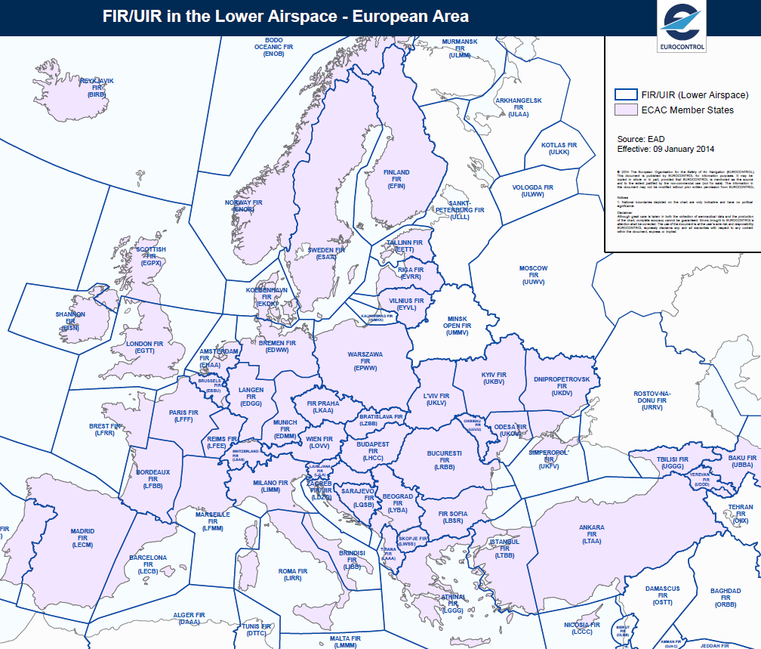
Main Problem
Upper airspace Lower airspace
Fragmented structure of Air Traffic Management (ATM) in Europe

Slide 5
Challenge
Developing one Single European Sky by which air
navigation is managed at an European level

Slide 6
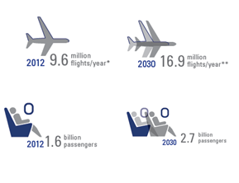
European Airspace

Slide 7
European airspace reached capacity limits
2030
16.9 million flights per year
2.7 billion passengers
2012
9.6 million flights per year
1.6 billion passengers
Higher CO2 emission
Higher costs for airliners
More delays
Costs of fragmented airspace: 4 billion annually (now)

Slide 8
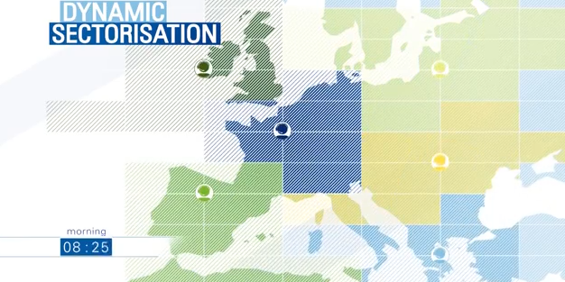
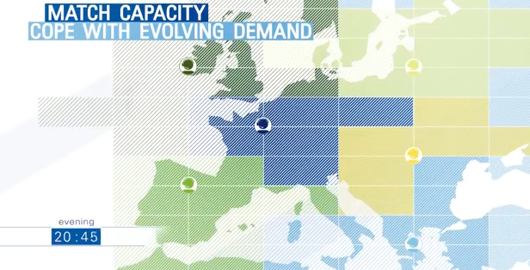
A Single European Sky
Restructure of European airspace

Slide 9
Needs for a Single European Sky
To create additional capacity
To increase the overall efficiency
To increase safety
To improve capacity and quality of service

Slide 10
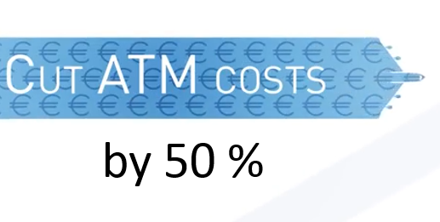
Goals of Single European Sky

Slide 11
Four Goals of Single European Sky
A three-fold increase in capacity, which reduces delays
Improve safety by a factor of 10
Environmental impact by – 10% per flight
Airspace users pay less than 50% of the current costs

Slide 12
Single European Sky ATM Research (SESAR) program for technical and operational solutions
Traffic synchronization
Airport integration and throughput
4-D trajectory
Network collaboration
Conflict management and automation
System Wide Information Management (SWIM)

Slide 13
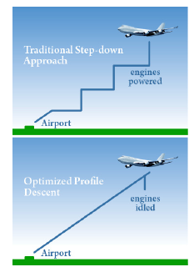
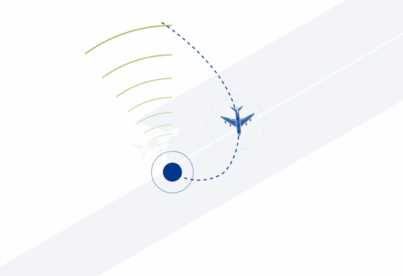
1. Traffic synchronization

Slide 14
First business needs
Satellite-based system makes an instrument landing possible independently of ground-based infrastructure
Optimization of climbing and descending traffic profiles
Approach with vertical guidance
Improved traffic sequencing

Slide 15
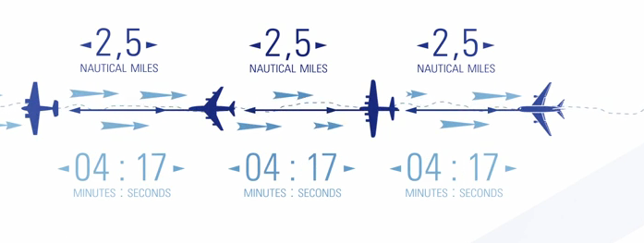
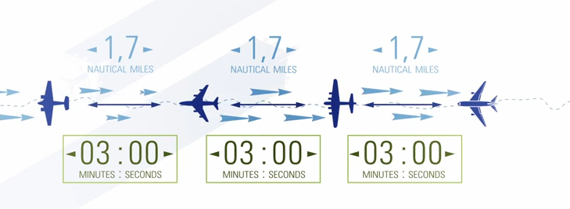
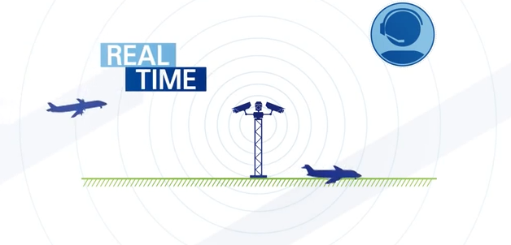
2. Airport integration and throughput

Slide 16
Second business needs
Integration of small regional airports by sharing electronic data
Remote tower concepts enables air traffic services and flight information
Time-based separation provides consistent time spacing (no longer spacing in miles)

Slide 17
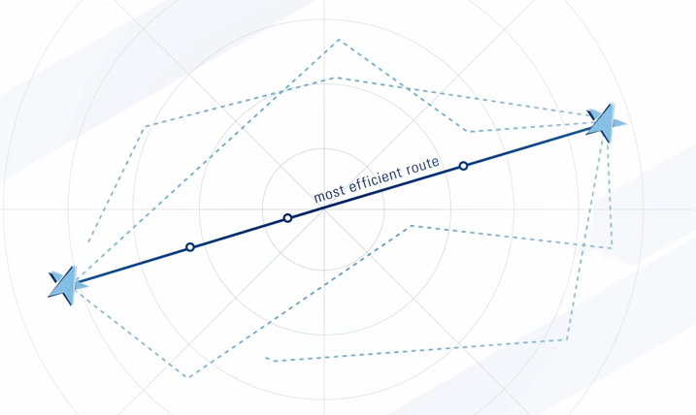
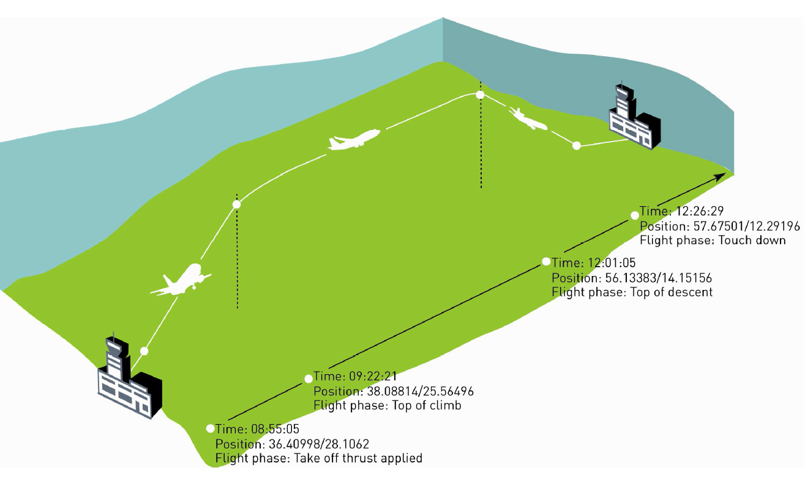
3. 4-D trajectory

Slide 18
Third business needs
4-D is: latitude, longitude, altitude, and time
Air and ground participants share a common view of the aircraft trajectory
Dynamic adjustment of airspace characteristics to meet the demands
Direct routing with a published entry and exit point

Slide 19
4. Network collaboration

Slide 20
Fourth business needs
Efficient network with collaboration and information sharing (between different air traffic controllers)
Short-, medium-, and long-term planning
Covers flexible military airspace demands
Dynamic capacity management by grouping and de-grouping sectors

Slide 21
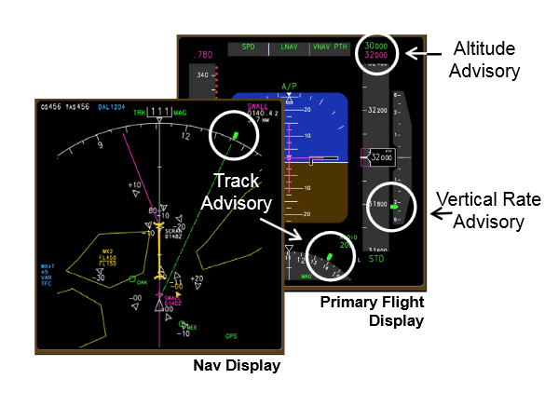
5. Conflict management and automation

Slide 22
Fifth business needs
By limiting the risk of collision through aircraft trajectories
Earlier warnings
Lower false rates
Decision-making toolkit designed for the air traffic controller
Collison avoidance system designed for the flight crew

Slide 23
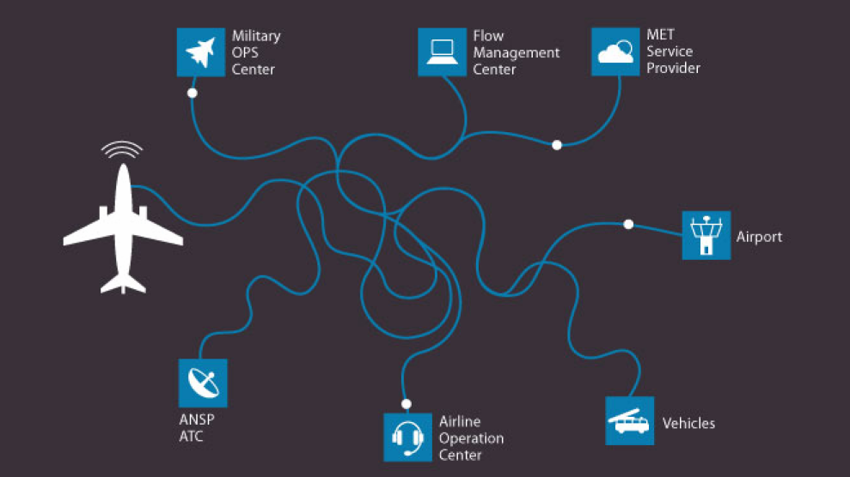
6. System Wide Information Management (SWIM)
Sharing information
today
Sharing information
tomorrow
The intranet of the Air Traffic Management

Slide 24
Sixth business needs
Greater sharing of air traffic management information
The right information at the right time to the right person
Aeronautical items, airport, flight, meteorology, surveillance, flow, capacity and other information

Slide 25
SWIM data exchange

Slide 26
SWIM data exchange make use of
Loose system coupling makes the interfaces compatible
Open standards creates availability to the public
Service Oriented Architecture (SOA) provides services for external and internal clients

Slide 27
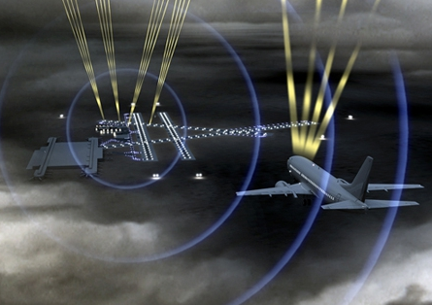
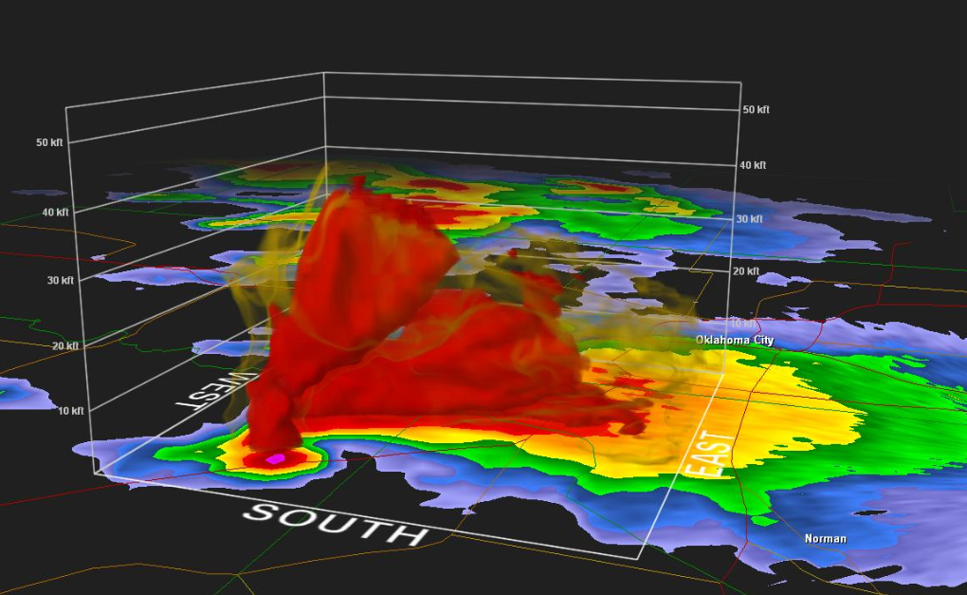
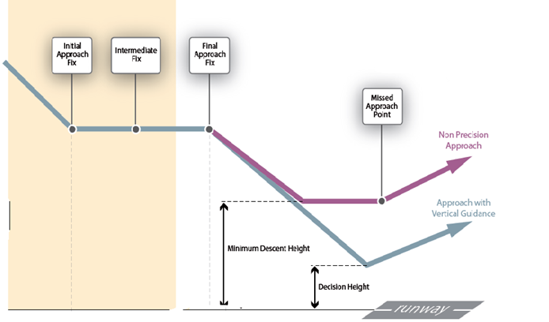
Changes for the Flight Crew
Satellite based navigation and surveillance
Digital route information
Weather forecast in an integrated solution
Landing under lower visibility conditions

Slide 28
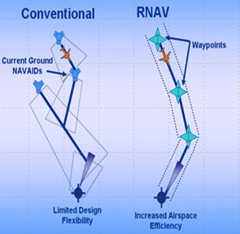
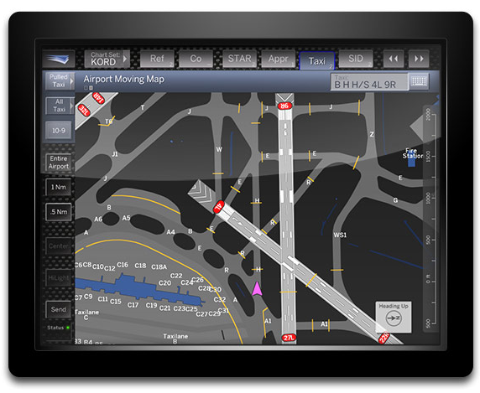
Area Navigation (RNAV) for a more accurate position
Optimized profile descent
Aircraft progress on the moving map
Some spacing responsibilities

Slide 29
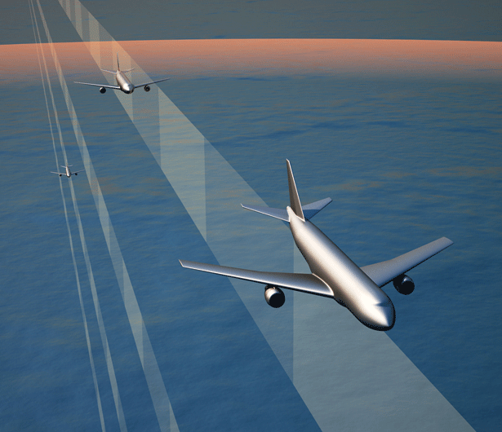
Pilots are given more tasks

Slide 30
These tasks are
Specific timing constraints at designated waypoints
Spacing time from a designated leading aircraft
Decision making for unpredicted events such as: terrain, weather, and obstacles avoidance
Conflict prevention

Slide 31
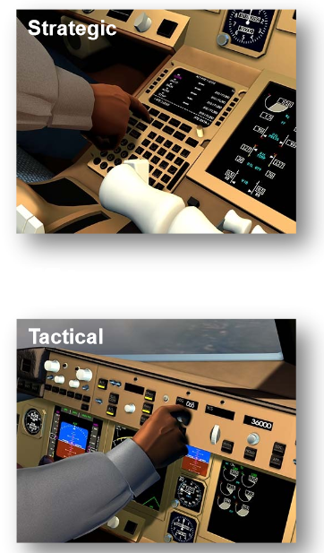
Conflict prevention
Strategic operation
via Flight
Management
System (FMS)
If intruder is
further away
Tactical operation
via Mode Control
Panel (MCP)
If intruder is
nearby

Slide 32
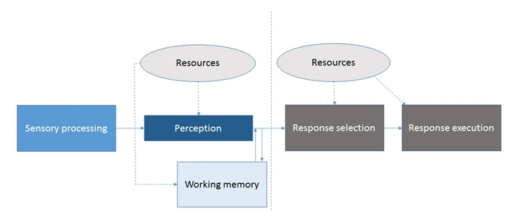
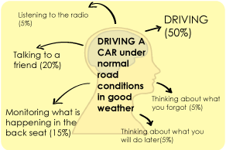
Mental workload

Slide 33
Definition of Mental workload
The “cost”, in information processing terms, of performing a given task
A duel-task performance defines the limits of a flight crew’s workload in terms of the number of tasks that can (or cannot) be performed within a unit of time

Slide 34
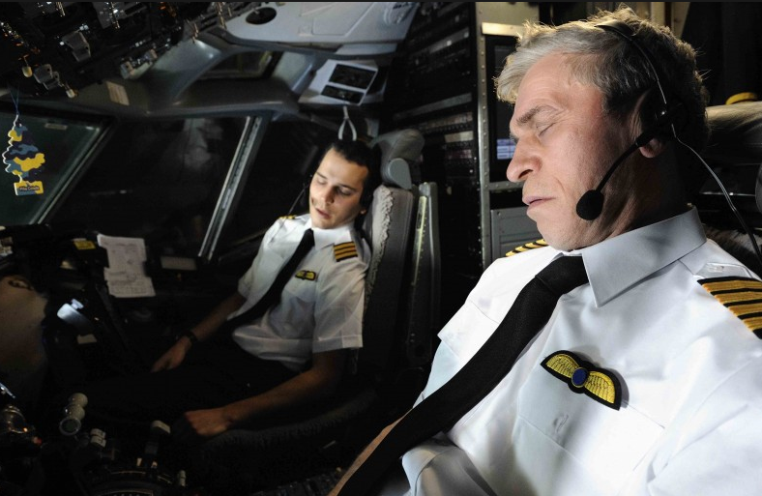
High-mental workload and under-load

Slide 35
Consequences of high-mental workload and under-load
High-mental workload is workload in terms of tasks that cannot be performed within in a unit of time
Under-load may reduce vigilance
Both can influence the flight crew’s (1) Situation Awareness, (2) performance and (3) decision-making in a negative way

Slide 36
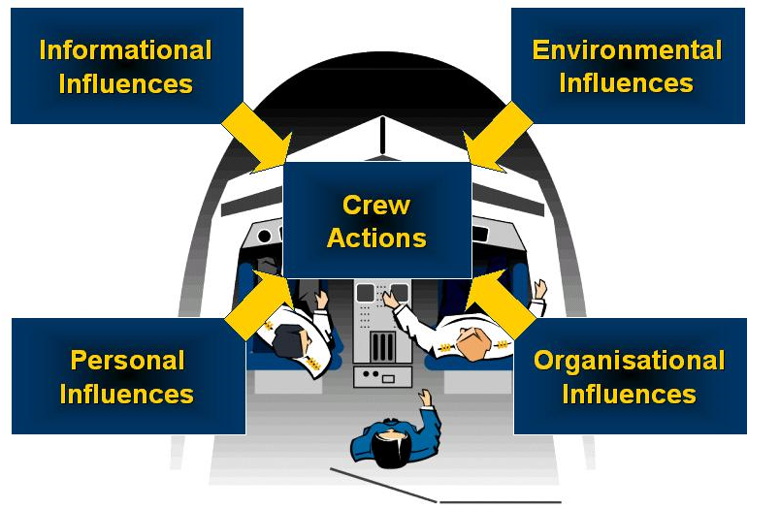
Definition of Situation Awareness according Mica R. Endsley
SA is:“(1) The perception of the elements in the environment within
a volume of time and space, (2) the comprehension of their meaning,
and (3) the projection of their status in the near future”

Slide 37
Three characteristics of Situation Awareness
Situation Awareness is goal-orientated
Situation Awareness directly supports the cognitive processes of the operator
Situation Awareness keeps the user in control

Slide 38
The three levels of Situation Awareness

Slide 39
Characteristics of the three levels of Situation Awareness
Level 1 SA: the flight crew perceives attributes of relevant elements through visual inputs, auditory inputs, or a combination
Level 2 SA: the flight crew comprehends what is perceived
Level 3 SA: the flight crew predicts what those elements will do in the near future

Slide 40
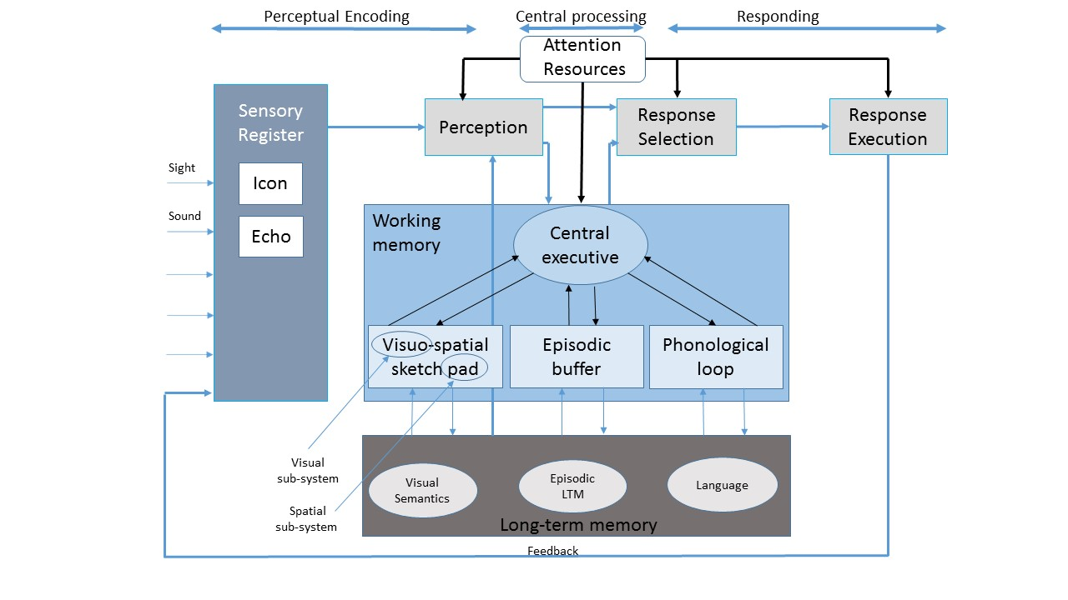
Wickens’s schematic model of human information processing

Slide 41
Three basic stages of human response
Perceptual encoding: interpreting and organizing of the sensory data
Central processing: storing and processing in a variety of ways
Responding: via speaking, writing, handling etc.

Slide 42
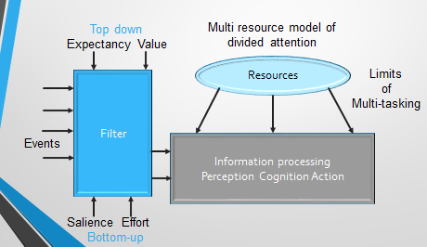
Top-down and Bottom-up processing of perceptual information

Slide 43
Top-down processing of perceptual information
Is goal directed: perception is based on knowledge, desires and context
Assumes the involvement of prior knowledge in interpreting perceptual information
Indicates signaling “what should be there”

Slide 44
Bottom-up processing of perceptual information
Is data driven: incoming data from the environment forms perception
Is based solely on the data available through the senses
Indicates “what is there”

Slide 45
The two bottlenecks for Situation Awareness
Bottleneck 1: Information requires attention and processing
Bottleneck 2: Information need to be stored in working memory

Slide 46
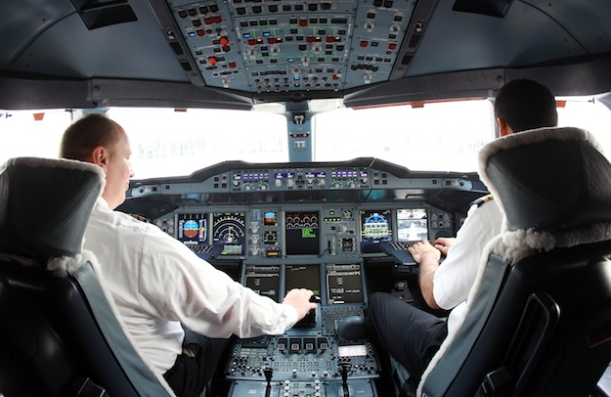
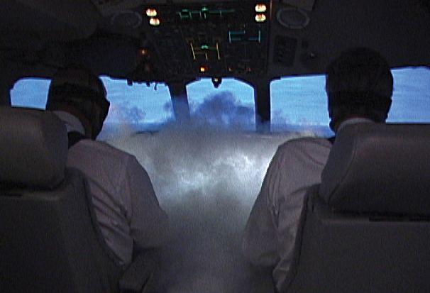
Bottleneck one for Situation Awareness

Slide 47
Information requires attention, and processing at the same time
Information comes through the same modality: visual, auditory (visual - visual; auditory - auditory)
Draws on the same sources of central processing (reading and multiplying 31 x 8)
Requires the same response mechanism: speaking, writing (speaking – speaking; writing – writing)

Slide 48
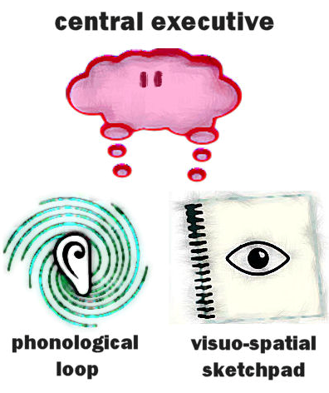
Bottleneck two for Situation Awareness

Slide 49
Information need to be stored in Working memory
Only a limited amount of unrelated information can be held and manipulated in working memory
7 plus or minus 2 “chunks”, (Miller’s law).
A chunk exists of digits in a list which are grouped and these groups are encoded as a single unit (a chunk)

Slide 50
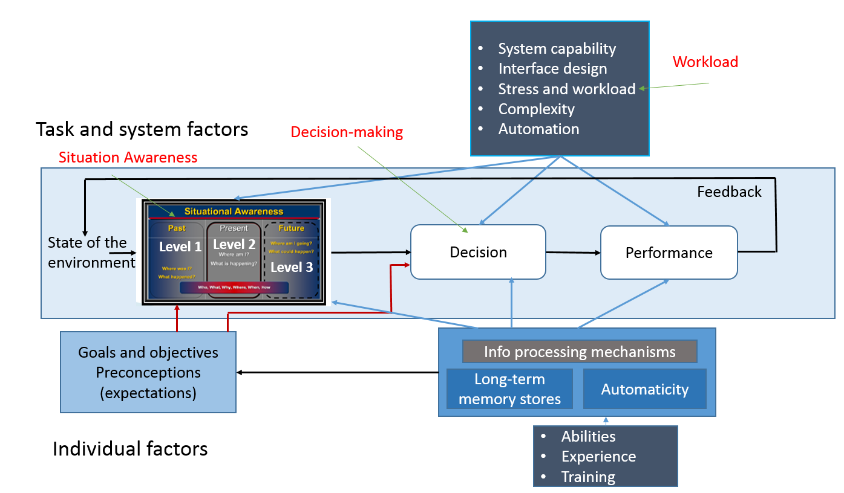
Model of Situation Awareness in dynamic decision making by Mica R. Endsley

Slide 51
Internal factors that affect Situation Awareness and decision making
Internal factors:
Goals, objectives and expectations
Long-term memory, information processing and automaticity
Abilities, experience and training

Slide 52
External factors that affect Situation Awareness and decision making
External factors:
System capabilities
Interface design
Stress
Workload
Complexity
Automation

Slide 53
Technology centered versus User centered

Slide 54
Technology centered design
Engineers develop sensors and systems that are needed to perform a function
As a result of technology centered design:
Humans can only adapt not create
Humans are error prone
Human-machine system is sub-optimized

Slide 55
User centered design
Engineers design the interface around the capabilities and needs of the human
As a result of user centered design:
Errors are reduced
Productivity improved
Safety improved
Acceptance improved

Slide 56
User-centered design technology
Organized around a users goals, tasks, and abilities
Technology should be organized around how users process information, and make decisions
Technology must keep the user informed and in control

Slide 57
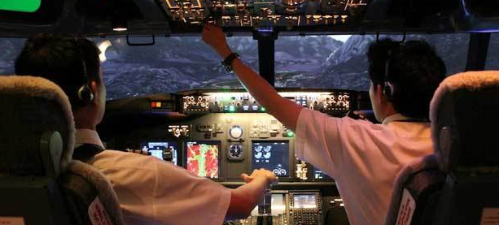
1. Organized around a users goals, tasks, and abilities

Slide 58
User centered design is more suitable for complex
systems where users require:
To pursue a variety of competing goals
In a specific timeframe
In which the sequence of tasks or actions is difficult to describe
With User centered design the user will be supported in their goals, tasks and abilities

Slide 59
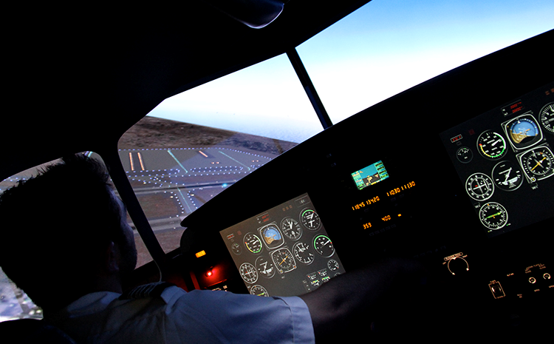
2. Technology should be organized around how users process information, and make decisions

Slide 60
User centered design support the user with:
Classification of the current situation
Pattern matching mechanism for quickly understanding the situation
Choosing the appropriate course of action
With User centered design the user will be supported in gaining and maintaining Situation Awareness, which forms the basis for decision making

Slide 61
3. Technology must keep the user informed and in control

Slide 62
Technology must:
Allow the flight crew to be in control
Support, and not replace the flight crew
Inform the flight crew
Not make decisions
With User centered design the user will be informed and in control for optimal Situation Awareness and successful performance

Slide 63
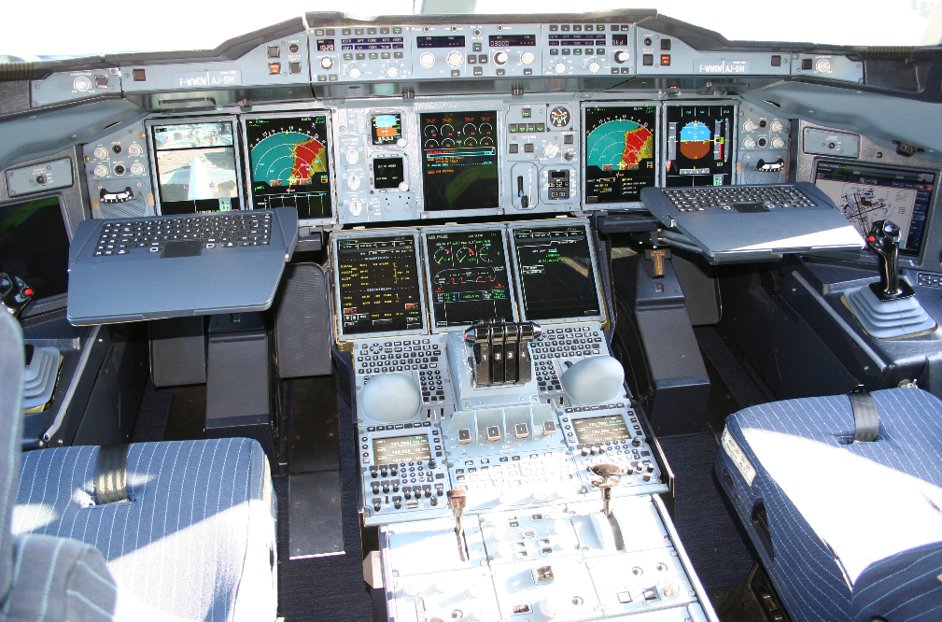
Cockpit Airbus 380

Slide 64
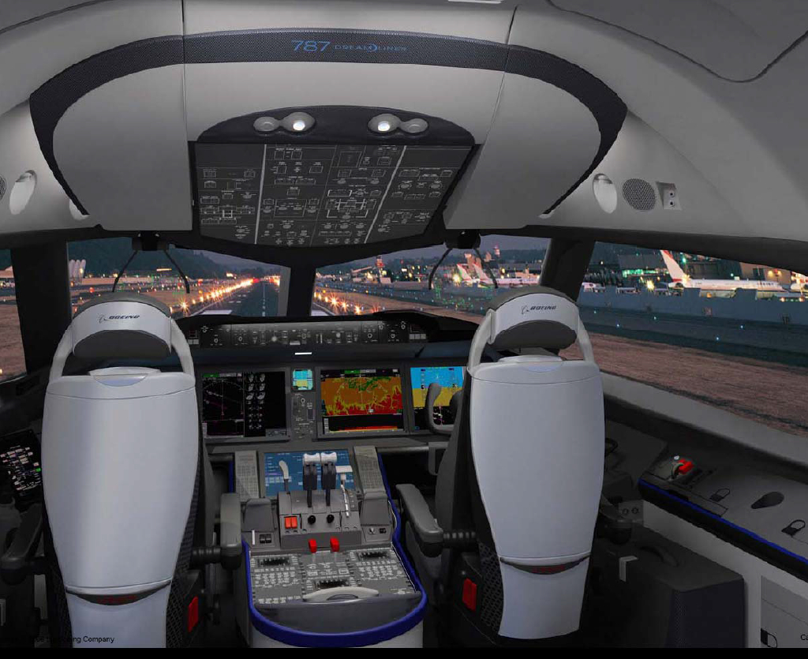
Cockpit Boeing 787

Slide 65
Conclusion

Slide 66
Conclusions
SESAR brings:
Technical, operational and responsibility changes
Increased cognitive activities and decision-making
Quality of decision-making is related to Situation Awareness, and mental workload
With User centered design the flight crew will be:
Supported in their goals, tasks and abilities
Informed and in control
Supported in gaining and maintaining Situation Awareness, which forms the basis for decision making

Slide 67
http://www.sesarju.eu/node/1715
June 2014
SESAR simulation

