Slide 1

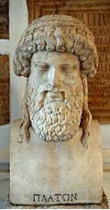
PlatoMundi a voyage with Er
Helena Barbas
Universidade Nova de Lisboa
CENTRIA – Centre for Artificial Intelligence
Bruges Novotel Centrum, Bruges, Belgium
16th April 2009

Slide 2
PlatoMundi.1 has been presented
as a preliminary trans-domain proposal
for a COST-Action (EU)
More partners will be needed to foster this game development project
It fits the agenda of the ICT - Information and Communication Technologies - Work Programme 2009-10, of the EC Fp7

Slide 3
Theme: the Myth of Er, as narrated in Book X of Plato’s Republic (612a-621d):
A man named Er dies in battle. Twelve days later, on the pyre for his funeral, Er awakens and tells us about his journey through the other world. He describes the respective entities, actions and geography
Issues: Justice; Individual responsibility for actions and choice

Slide 4
Objective: to develop an adventure/quest browser immersive, multiplayer, 3D MMORPG serious video game
Subjects: Mythology, Ethics, History, Philosophy and Citizenship
Target group: players of all ages, genders and nationalities

Slide 5
Put the latest technical and graphical development of video-games software at the service of edutainment
Respect cultural traditions and mythology
Avoid all kind of useless violence
Design the tasks to develop thinking skills
Carefully address gender issues

Slide 6
The most successful games explore utopia worlds graphically designed with extraordinary aesthetical qualities
BUT
Their mythologies and characters are mixed up in unrecognizable cosmological cocktails

Slide 7
plot wise, the majority are war/conflict games
BUT
the user-hero - even if female - has to develop warrior expertise through violent activities to win

Slide 8
The tasks proposed are conceived for the accretion of points/speed of action
BUT
without any kind of ethical or historical considerations

Slide 9
PlatoMundi virtual 3D worlds will be as faithful as possible to the platonic proposals:
  resort to cosmological or mythological references present in other dialogues (Timaeus, Phaedrus, Phedon, i.e.).
  Use contemporary images
  Use later date images representing Plato’s worlds

Slide 10
Plato’s Geography ( Myth of Er + Timaeus)
Oceanus
Earth
Cocitus
Hades
Acheronte
Lake Acherusia
Piriphlegetonte
Tartarus

Slide 11
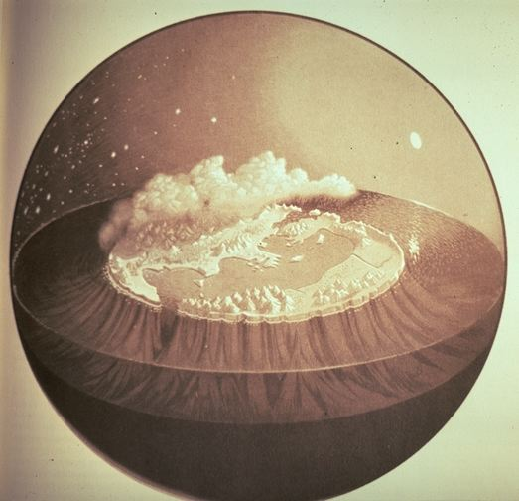
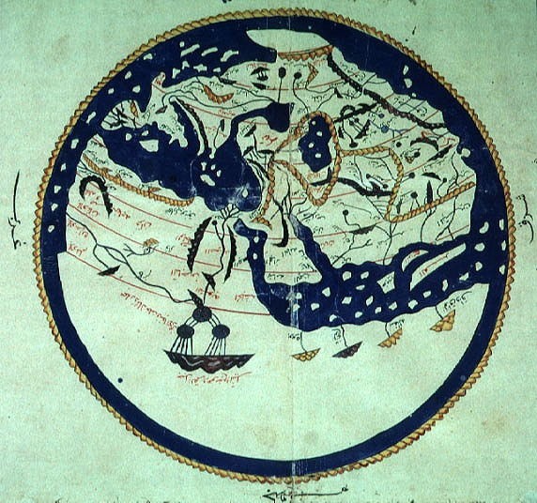
Plato’s Geography
Al-Idrisi Map (1099-1166)

Slide 12
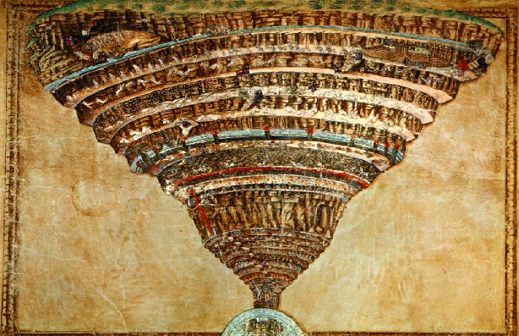
Dante’s Inferno by Boticelli (c.1480)

Slide 13
Software: Free Open Source platforms and programs - i.e.
  Source Engine (Valve) – extensible, modular environment for PC and console games that combines leading-edge tools
  Maya (Autodesk) free to download for student or academic purposes

Slide 14
Concerning visual game design: special emphasis is to be given to aesthetics role in this game experience
The drawings will be original, inspired from the classic arts
They will avoid stereotyped, gloomy or childish representations (anime or machimina)

Slide 15
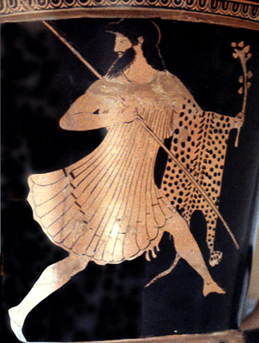
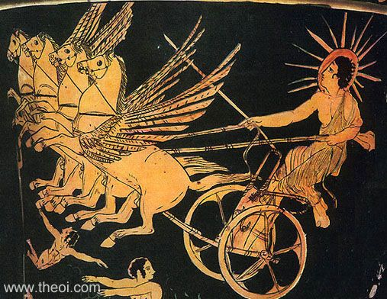
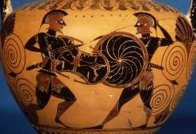
Dyonisus running
Helios’ Charriot
Fight

Slide 16
From storytelling will depart game conceptual and practical design (bible, visual and audio elements, interfaces, etc.)
In this kind of narrative spaces (worlds and scenarios) are determinant for plot and characters, as well as action development and task planning

Slide 17
Geography will be distributed by four worlds – Earth, Limbo, Heaven and Hell – all interconnected through the Rainbow column and Styx river
The interconnection and interaction between levels will open the passageways for characters/tasks

Slide 18
Characters will be able to walk, run, and hide
Other activities are:
  giving orders
  negotiate
  solve enigmas
  answer questions
  role-play
  tasks
  find objects

Slide 19
Magical objects / tokens:
The Gyges ring
Hades helm of darkness
both providing invisibility
Invisibility will be used as a way of acting strategically in order to accomplish the tasks

Slide 20
Normal objects / tokens:
One livery collar that the user will receive empty at the start of the game
Every success will be rewarded with precious stones/points
These jewels will be used for trade-offs and assessment purposes

Slide 21
Two avatars - Pamphylia (female) and Pamphylius (male) - young humans without any superpowers
Main adjuvant – Er, a human guide/ messenger; he wants to help, but may make mistakes
Oracular – a couple of Philosopher(s) Socrates/Hypathia; each will serve as guide/daimon; (introduction of AI to support the best moral decision)

Slide 22
In the case of ER, the main predicament would be the relation between the just and unjust man
This issue will also be included in the story as part of the action, considered in the reckoning of the rewards to be received by the player

Slide 23
Storytelling will evolve through a multi-leveled plot:
  Narrative: as described in the Myth
  Gameplay: the tasks to be accomplish in a given period of time
  Phylosophical/moral: the tasks/obstacles embedded in the plot, as actions to be/or not to be taken
The questionnaires, quizzes/enigmas to be solved with syllabus content

Slide 24
The plot has been structured following narratological theories (Todorov/ Barthes/ Greimas). It is divided into two main sequences:
  The arrival of Er/users to Limbo, and the distribution of lives
  The trip from the plain of Lethes to the return to earth/fall into the Cave
Learning content will be shaped within the action sequences

Slide 25
This project has been prepared as a first-phase/test-bed for the launching of more complex and longer developments
Plato’s Works are translated in almost every language in academic editions
  large scope of audience
  guarantee of scientific credibility
PlatoMundi can become an original and dynamic cultural heritage preservation project

Slide 26
ISSUES TO BE ADDRESSED
Creation of a web database – wiki/ moodle/ encyclopedia-wise – with all the possible information on the game and themes developed, syllabus, forum and communities
The users (student / teacher) will be allowed to contribute to it, with different levels of access

Slide 27
ISSUES TO BE ADDRESSED
Development of a methodology for serious games evaluation:
  Creation of control groups
  Creation of a taxonomy
  Systematization of the results

Slide 28
ISSUES TO BE ADDRESSED
Contribute to a new educational theory:
  Approaches to edutainment are tainted by traditional learning theories (Behaviourism, Cognitivism, Constructionism, the Socio-cultural approach, on the way to Blended learning)
  They do not consider the specifics of ludology, nor the fresher proposals of the cognitive sciences

Slide 29
In edutainment - how to transfer game concepts to the classroom:
  trade-offs / playability
  intrinsic/extrinsic motivations /immersion
  freedom/ control / mastery
  the game may log the number of mistakes and self-corrections
  the tutorials provide gradual information

Slide 30
In edutainment - how to transfer classroom concepts to the game:
  logging features and tracking potential that allow the users to enhance their performance
  how to let the student actions adjust the game/learning variables

Slide 31
ISSUES TO BE ADDRESSED
Assessment:
Measurement has to start at the software and game design stages
  It has to follow the trend of UCD (User-centred design)
  Must consider the implications of continuous appraisal (hesitations, doubts)
What kind of teacher/monitor grading
And cheating will always be a challenge

Slide 32
Thank You
PlatoMundi - a voyage with Er
Helena Barbas - UNL - CENTRIA – Portugal
hbarbas@fct.unl.pt
hbarbas@gmail.com

